Slide 1
2019 Autumn Realtime Graphics
3D COMPUTER GRAPHICS
BASIC
Masaki Hayashi

Slide 2

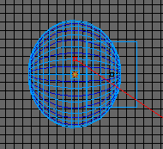
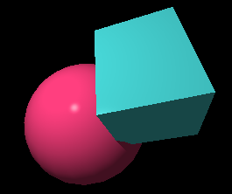
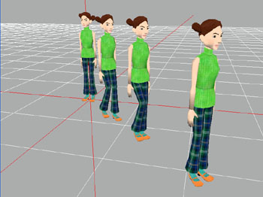
3 (or 6) phases in CG
Modeling
Rendering
Animation
Modeling
Lighting
Animation
Make a scene
Rendering
Camera

Slide 3
1. Modeling
y
Polygon
Solid model
Voxel
(1) To make a shape
x
z
Material
(2) Coloring
UV mapping
Mip-map
(3) To put a texture
y
(4) Placement in a space
Coordinate system
Viewing transformation
x
z

Slide 4
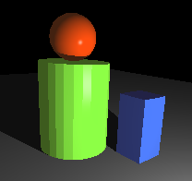
2. Rendering
light
light
camera
y
Lighting
Camera
x
z
objects
Effect
Shading and cast shadow
Reflection and refraction
Fog
Halo
Lens simulation (Defocus, motion blur, flare, etc.)
Particle (smoke, flame, etc.)
Anti-aliasing
etc.

Slide 5
3. Animation
y
Object animation
Light animation
Camera animation
z
Character animation

Slide 6
Modeling

Slide 7
Coordinate system
xyz coordinate
(y is upward, z is front)
Left-handed
Right-handed
y
y
y
z
x
x
x
z
z
Unity
DirectX
Mathematics
OpenGL

Slide 8
Coordinate system
Rotation
Left-handed
Right-handed
y
y
Counter-clockwise
Clockwise
x
x
z
z
Unity
DirectX
Mathematics
OpenGL

Slide 9
Modeling
1) Surface model
Most popular
Easy to control
Needs much data
OpenGL handles this
- Polygon
- Curved surface represented by mathematical formula.
(Bessier, Spline, NURBS, ...)
=> B-rep (boundary representation)
2) Solid model
Primitives
Stitching surfaces
Mass, volume, physical things
Used in CAD
3) Voxel
Special use
Needs huge data
by CT, MRI scanning

Slide 10
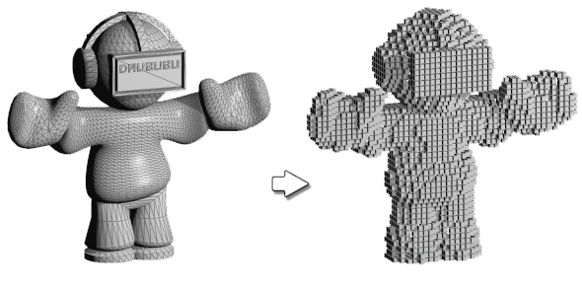
Polygon & Voxel
Polygon
Voxel

Slide 11
Polygon
Vertex
(x₀, y₀, z₀)
Normal vector
(x₂, y₂, z₂)
(x₁, y₁, z₁)
Surface

Slide 12
Polygon data
A model is represented by 1) Vertex data,
2) Surface data and 3) Normal data
Vertex No. x y z
1 0.5 0.8 0.4
2 0.0 0.0 0.0
3 0.5 0.0 0.8
4 1.0 0.0 1.0
1
pyramid
(three-sided)
3
1
2
4
Surface No. Vertex No.
1 1 2 3
2 1 3 4
3 1 4 2
4 4 3 2
2
4
3
Normal vector
1
Normal No. x y z
1 -0.4 0.2 0.2
2 0.2 0.2 0.2
3 0.0 0.2 -0.4
4 0.0 1.0 0.0
Normal can be calculated by vertices. So it's omissible.
2
3

Slide 13
Rendering

Slide 14
Model visualization
Model visualization is done by getting an intersection point of a viewing line & a surface.
Then, the color of the point is calculated.
eye (camera)
y
object
x
z

Slide 15
1) Polygon
Intersection point is already there (it's vertex)
Other points can be easily calculated by interpolation.
That's why polygon representation has fast rendering speed.
y
interpolated
x
z
vertices

Slide 16
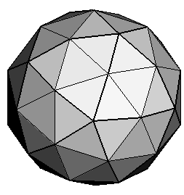
2) Primitive and B-rep
Primitive and B-rep can be visualized in two ways
e.g. Solid model sphere
(x² + y² + z² = r²)
Divide the surface to polygons
To solve a linear equation to get the points
y
y
or
x=at+b, y=ct+d, z=et+f
x
x
z
z
x² + y² + z² = r²
=> polygon solution
=> ray-tracing, etc.

Slide 17
Shading
Light
View
Surface
Reflected light consists of 3 components
Diffuse Light scattered equally to all direction
Material
&
Light
Specular Light reflected on metallic surface
Ambient Light of environment

Slide 18
Diffuse
θ
E_{d}
K_{d}
Diffuse
E_{d} = K_{d} cos θ
Not depending on a view point
K_{d} : Intensity constant of a material

Slide 19
Specular
α
E_{s}
K_{s} , n
Specular
E_{s} = K_{s} ( cos α ) ^{n}
Depending on a view point
K_{s} : Intensity constant of a material
n : gloss constant of a material
for small n : matte
large n : mirror

Slide 20
Ambient
No light source needed
E_{a}
K_{a}
Ambient
E_{a} = K_{a}
Not depending on a view point nor light sources
K_{a} : Intensity constant of a material

Slide 21
Phong shading model
Light
Material
K_{d} : diffuse
K_{s} : specular
K_{a} : ambient
n : gloss
Phong shading model
E = E_{d} + E_{s} + E_{a} ( + E_{e} )
Diffuse
Emission
Specular
Ambient

Slide 22
Parameters of material
diffuse color
specular color
ambiant color
Final color
gloss
r = d K_{dr} cos θ + s K_{sr} ( cos α) ^{n} + a K_{ar}
g = d K_{dg} cos θ + s K_{sg} ( cos α) ^{n} + a K_{ag}
b = d K_{db} cos θ + s K_{sb} ( cos α) ^{n} + a K_{ab}
d: intensity of diffuse
s: intensity of specular
a: intensity of ambient

Slide 23
Material
r = d K_{dr} cos θ + s K_{sr} ( cos α) ^{n} + a K_{ar}
g = d K_{dg} cos θ + s K_{sg} ( cos α) ^{n} + a K_{ag}
b = d K_{db} cos θ + s K_{sb} ( cos α) ^{n} + a K_{ab}
Different ratio of d, s, a, K_{d}, K_{s}, K_{a}, n gives
a surface look of specific material.
Examples:
Rubber : K_{d} > K_{s}, Small n, K_{d} is set to the surface color
Plastic : K_{d} < K_{s}, Bigger n , K_{d} is set to the surface color, K_{sr} = K_{sg} = K_{sb}
Metal : K_{d} << K_{s}, Biggest n,
(K_{sr}, K_{sg}, K_{sb}) is set to the color of the metal
=> Physically Based Shading (PBS)

Slide 24
Smooth shading
Polygon representation
Real sphere
How to get?
Flat shading
Smooth shading

Slide 25
Gouraud shading
color
color
color
②
Then, it calculates the color of the 3 corners by the normals.
③
①
Then, it performs linear interpolation of the 3 corner colors.
First, it calculates normals of corners by averaging the normals sharing the corner.

Slide 26
Phong shading
normal
normal
normal
②
Then, it interpolates the 3 normals to get a normal of a target point.
①
First, it calculates normals of corners by averaging the normals sharing the corner.
③
Then, it calculates the color using the normal.

Slide 27
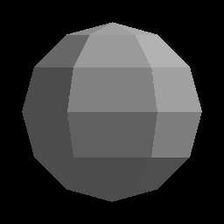
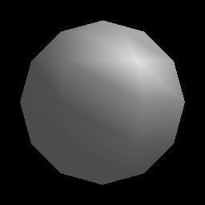
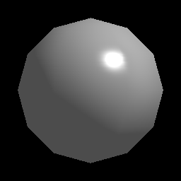
Comparison
Flat shading
Gouraud shading
Phong shading
- Fastest
- Jagged
- Fast
- Smooth
- Unnatural when less polygons
- Slow (10 to 100 times computation)
- Very smooth

Slide 28
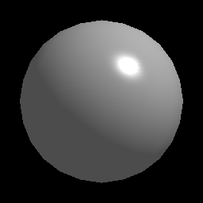
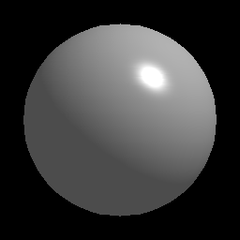
Smooth shading
Edge problem still left:
> To increase number of polygons
36 polygons
144 polygons
2500 polygons

Slide 29
Light sources
Light sources
Directional light
Positional light
Ambient light - attenuation
Flat light
- direction
- attenuation
Point light
- position
- attenuation
Spot light
- position
- direction
- cone size
- attenuation
(Global illumination)
note: Multiple light sources simply increase the computation.

Slide 30
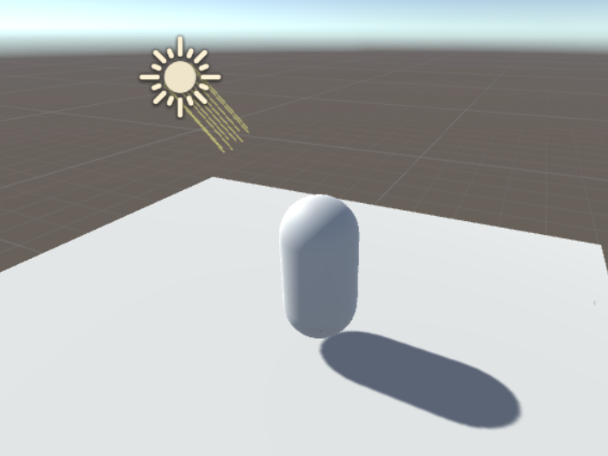
Shadow
Physical simulation gives shadows automatically. (e.g. Ray-tracing)
But, the ray-tracing needs huge computation time, hard to work in real-time.
So, other method such as "Shadow mapping" is used.
Creates "shadow map" from the light source view.
Tests whether a pixel is visible from the light source.
Renders the scene.

Slide 31
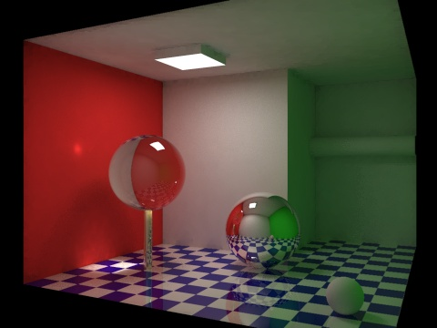
Global illumination
Physical simulation of indirect lights (e.g. Walls illuminate walls)
Photo-realistic
Computationally expensive
Super accurate simulation of the conventional "Ambient light"
Calculates physical lighting effects in a static scene.
Stores the result on a memory.
Calculates global illumination effects in the scene using the result in real-time.
Light sources can move in real-time but objects cannot move.

Slide 32
Viewing
Vertex (x, y, z, 1)
Modeling
Transformations
Viewing
Transformations
Perspective
projection
Screen
y
y
x
x
-z
z
object
camera
- translation
- rotation
- scaling
screen
- translation
- rotation
- projection

Slide 33
Matrix operations
a d g x₀
b e h y₀
c f i z₀
0 0 0 1
x'
y'
z'
1
x
y
z
1
=
4 x 4 Matrix is used for transformations
(Homogeneous coordinate)
1 0 0 dx
0 1 0 dy
0 0 1 dz
0 0 0 1
1 0 0 0
0 cos -sin 0
0 sin cos 0
0 0 0 1
cos 0 sin 0
0 1 0 0
-sin 0 cos 0
0 0 0 1
cos -sin 0 0
sin cos 0 0
0 0 1 0
0 0 0 1
Translation
x-axis
z-axis
sx 0 0 0
0 sx 0 0
0 0 sx 0
0 0 0 1
y-axis
Rotation
Scaling

Slide 34
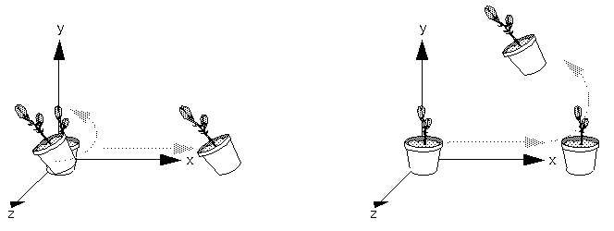
Multiplication order
Rotating First or Translating First
v' = N M L v
where
L : scaling matrix
M: rotation matrix
N : translation matrix

Slide 35
Perspective projection
h
x_{s} = x
z
h
y_{s} = y
z
(x, y, z)
(x_{s}, y_{s})
vertex
h

Slide 36
Hidden surface removal
Hidden surface removal
All the surfaces are visible
Hidden surface invisible

Slide 37
Rendering methods
Z-buffer
Most popular, Less computation
Scan line algorithm
Able to handle transparent objects
Ray-tracing
Beautiful output, able to represent transparency & refraction effects, Easy to make shadows, Much computation,
Most popular for the off-line rendering.

Slide 38
Z-buffer
distance
Get a distance value for all the pixel on a screen and save them in the z-buffer
Z-buffer is used in a rendering phase
Screen
Z-buffer
To compare a distance between a vertex and a view point with a corresponding value on the z-buffer for hidden-surface removal

Slide 39
Ray-tracing
Tracing stops when the number of reflection exceeds a given max number to avoid huge amount of computation
Whether a light is visible from the point.
Transparent object
Tracing stops when it hits an opaque object
Transparent object
Simulation of reflection & refraction
Opaque object
Calculate an intersection point
Screen
Trace a ray from the view point to the world for all the pixels on a screen

Slide 40
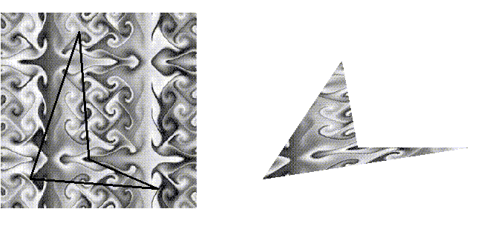
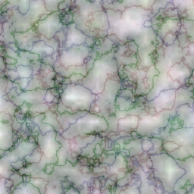
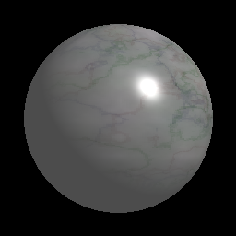
Texture mapping
Texture image
Texture mapped object

Slide 41
UV mapping
u
(x₁, y₁, z₁)
(x₄, y₄, z₄)
v
Texture
Polygon
(x₃, y₃, z₃)
(x₂, y₂, z₂)

Slide 42
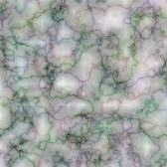
UV mapping
u
v
Texture
Polygon
Aliasing noise becomes a problem when the texture image is shrinking.
Polygon

Slide 43
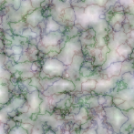


Mip-map
Texture
Shrunk images are made in advance. Sizes are 1/2, 1/4, 1/8, 1/16,...
If the texture gets too much blur when it's shrunk, try check the Mip-map parameter.

Slide 44
Animation
To give movements
Object position, orientation
Object shape, color, etc.
Camera position, view direction, zoom, etc.
Lighting position, direction, brightness, etc.
Sun
Mathematical formula
Keyframe
Motion capture
Earth
#0
#1
#2
#3
Interpolation

